Slide 1

Tenacity.AI
Empowering E-Learning from Media content.
Arpit Jain
Gautam Yadav
Bhupendra Singh

Slide 2
We want to enable our users to create more Powerful and Impactful Video content for better learning and Insightful data communication in the process of E-Learning.
Our Aim

Slide 3
Tenacity.AI is a web app that simplifies the process of gaining Insights from Visual content(mp4).
Tenacity.AI is a tool that is helpful for both Tutors and Students.
With the help of Emotional(Tone) and Speech to text analysis, Tutors can Monitor their Lecture Delivery Style and productivity. Also, They can generate transcripts (Real Time) of their video lectures.
Further, with the help of Natural Language Understanding, Tenacity.AI extracts useful Keywords from Lengthy Lectures or complicated Jargons and thus provokes better learning by the students. Each of these keywords generated in real-time are automatically linked to Wikipedia pages for further information.
Tenacity.AI

Slide 4
How Tenacity.AI works?
Our group felt that E-learning experience did not give a student full immersion into the content of the video. Our Demo Web Application demonstrates that how Video Content can be utilized in order to generate better insights into the domain of E-Learning.
Our Application Uses the Watson APIs to Analyze the Video (mp4) files. The Watson Cognitive Services that we are utilizing are Tone Analyzer, Speech-To-Text and Natural Language Understanding. Our Application analyses the video to identify the tone and emotion of the speaker and generates the corresponding Transcripts.
After the complete video has been analyzed, our App suggests possible features to enrich in the video.

Slide 5




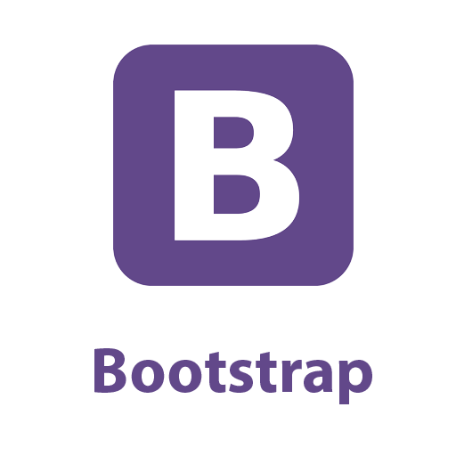


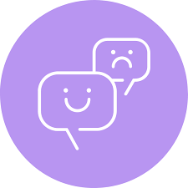
Tech Stack
Watson API
Bootstrap
Angular JS
Node.js
IBM Cloud Services
Speech-To-Text
Tone Analyzer
Natural Language Understanding

Slide 6
References
Watson Developer Cloud
Watson Starter Kits / GitHub
Watson API Documentation
Watson Cloud Services
Stack Over Flow
Node.js Documentation

